Slide 1
Predicting Appliance Energy Consumption in Households
Comparative Analysis of Machine Learning Models for Energy Consumption

Slide 2
INTRODUCTION
The Appliance Energy Prediction dataset contains information related to household appliance energy consumption, indoor environmental conditions, and outdoor weather variables.
The primary objective of this project is to predict appliance energy consumption using machine learning techniques.
Each observation in the dataset represents a 10-minute interval, resulting in a total of 19,735 records.
The data was collected continuously over a period of approximately 4.5 months.
The dataset includes features such as temperature, humidity, weather conditions, lighting usage, and other environmental factors that may influence energy consumption.
Various machine learning models are developed and evaluated to identify the most accurate approach for energy prediction.
Accurate energy consumption forecasting can support efficient energy management, reduce waste, and contribute to sustainable resource utilization.

Slide 3
Problem Statement
Household energy consumption is increasing due to the growing use of electrical appliances.
Accurate prediction of appliance energy usage is essential for improving energy efficiency and reducing wastage.
Energy consumption is influenced by multiple factors such as temperature, humidity, weather conditions, and lighting usage.
Traditional methods often fail to capture complex relationships between these variables.
Therefore, there is a need for a reliable machine learning-based solution to predict appliance energy consumption accurately.
Objectives
To analyze the factors affecting appliance energy consumption.
To perform data preprocessing, feature engineering, and exploratory data analysis.
To build and compare multiple machine learning models for energy prediction.
To evaluate model performance using metrics such as R² Score and Mean Squared Error (MSE).
To apply cross-validation and hyperparameter tuning for model optimization.
To identify the most important features influencing energy consumption.
To develop an accurate and reliable model for predicting household appliance energy usage.
To support efficient energy management and optimize energy utilization.

Slide 4
DATASET OVERVIEW
APPLIANCE ENERGY PREDICTION DATASET
Total Records
19,735
Features
29
Data Collection Period
4.5 Months
Observation Interval
10 min
Attribute | Value
Target Variable | Appliance Energy Consumption
Missing Values | None
Indoor Sensors | Temperature & Humidity Sensors
Weather Features | Temperature, Humidity, Wind Speed, Pressure, Visibility
Feature Engineered Variables | Temperature Difference, Humidity Difference
Data Type | Time-Series Sensor Data
Prediction Type | Regression
Energy Unit | Wh (Watt-hour)
Dataset Highlights
Contains appliance energy consumption and environmental sensor measurements.
Includes indoor temperature and humidity readings from multiple rooms.
Weather-related variables such as outdoor temperature, humidity, pressure, wind speed, and visibility are included.
Each observation represents a 10-minute interval.
Suitable for regression-based machine learning tasks.
Designed to support energy consumption forecasting and smart energy management.

Slide 5
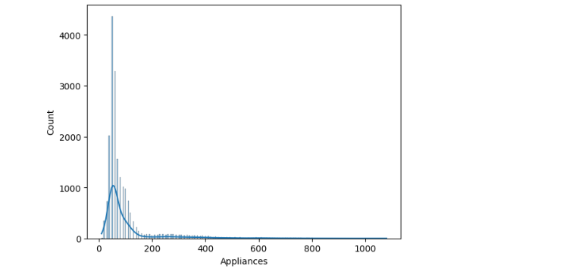
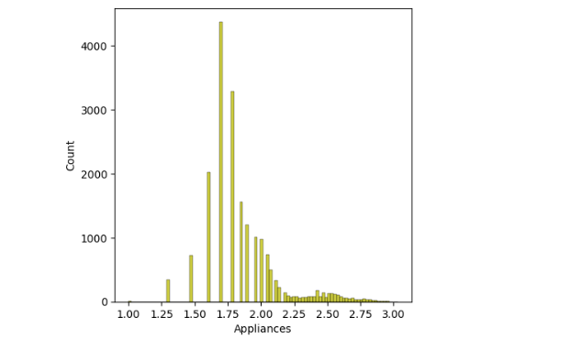
EXPLORATORY DATA ANALYSIS
KEY OSERVATIONS
The original Appliances distribution is highly right-skewed, with most observations concentrated at lower energy consumption values.
A small number of extreme values create a long right tail, indicating the presence of outliers.
After applying log transformation, the distribution becomes more balanced and less skewed.
The impact of extreme energy consumption values is significantly reduced.
The transformed distribution is closer to a normal distribution, making it more suitable for machine learning models.
Log transformation helps improve model performance by reducing the influence of outliers and stabilizing the variance.

Slide 6
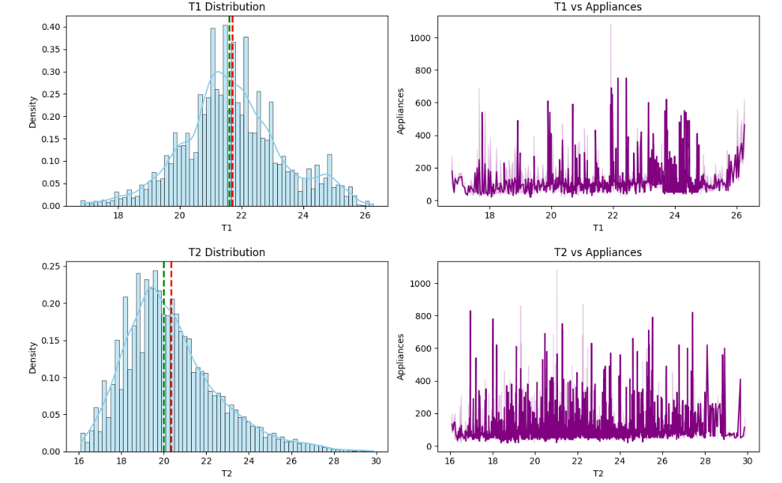
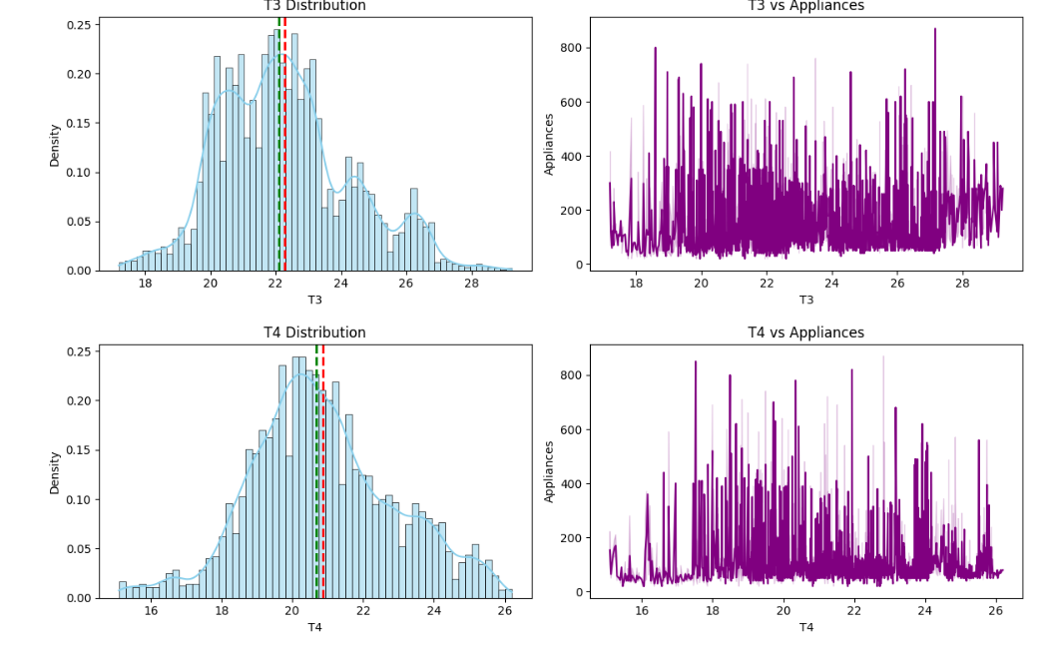
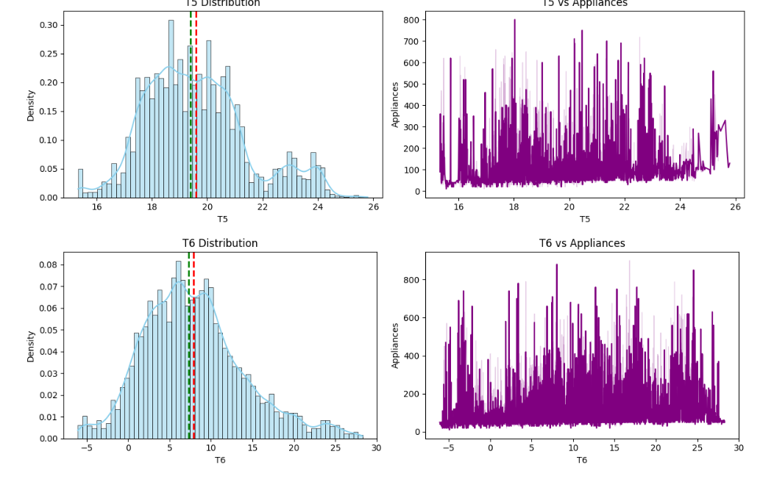
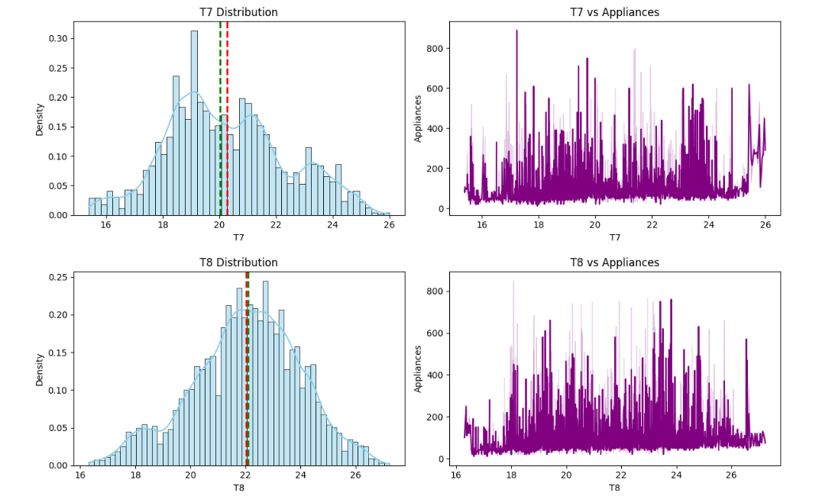
Temperature Distribution and Relationship with Appliance Energy Consumption

Slide 7
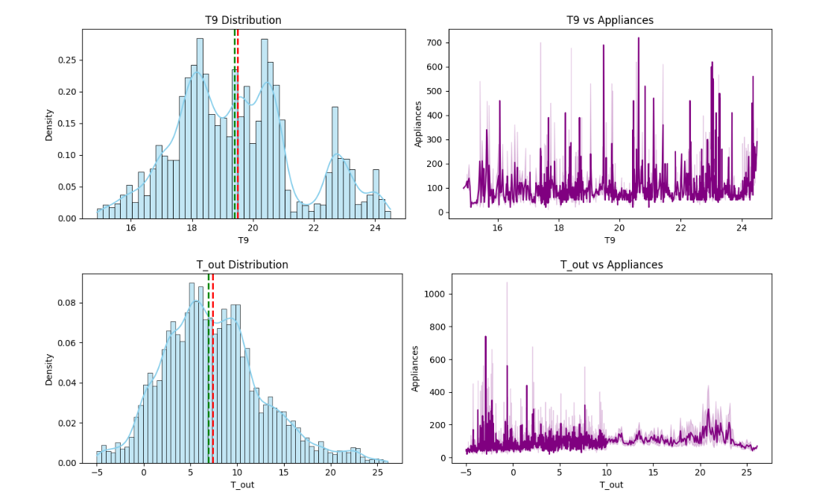
KEY OBSERVATIONS
Most temperature features (T1–T9) show approximately normal distributions with mean and median values close to each other.
Indoor temperatures remain relatively stable, indicating consistent environmental conditions.
Outdoor temperature (T_out) shows greater variation compared to indoor temperatures.
No strong linear relationship is observed between temperature features and appliance energy consumption.
Energy consumption varies across all temperature ranges, suggesting that temperature alone is not a major predictor.
Temperature features may still contribute valuable information when combined with other environmental variables.

Slide 8
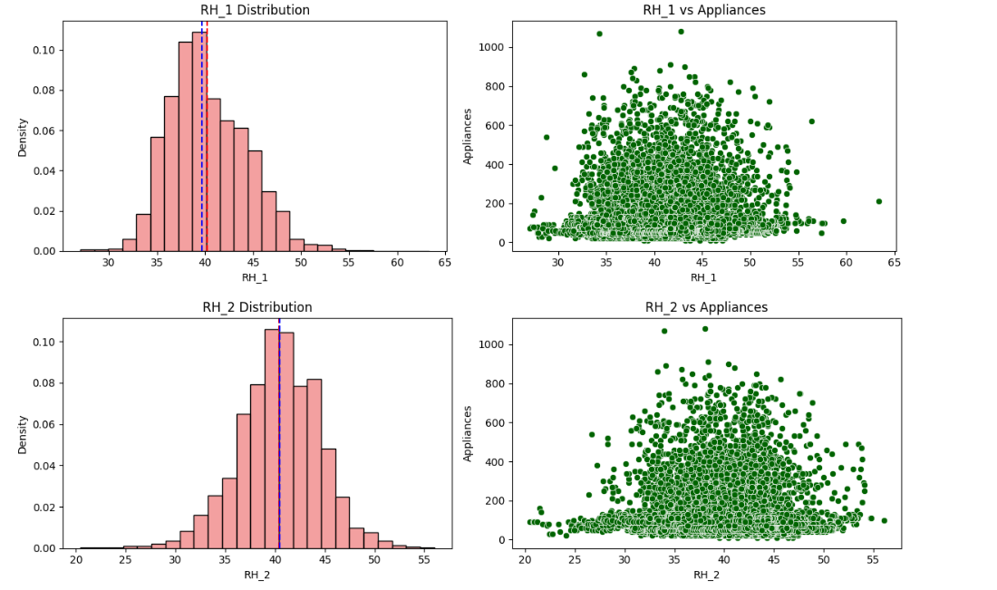
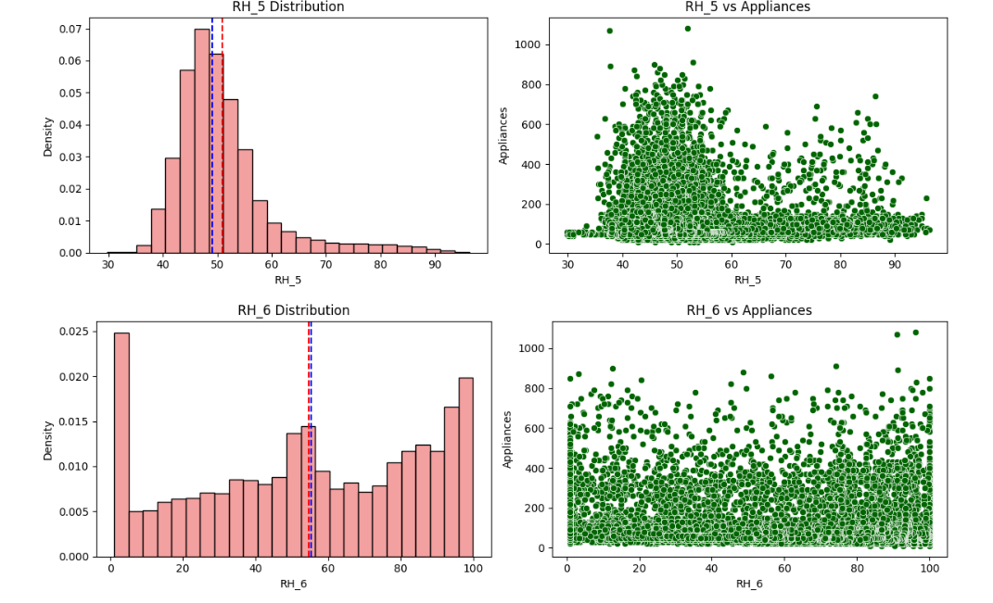
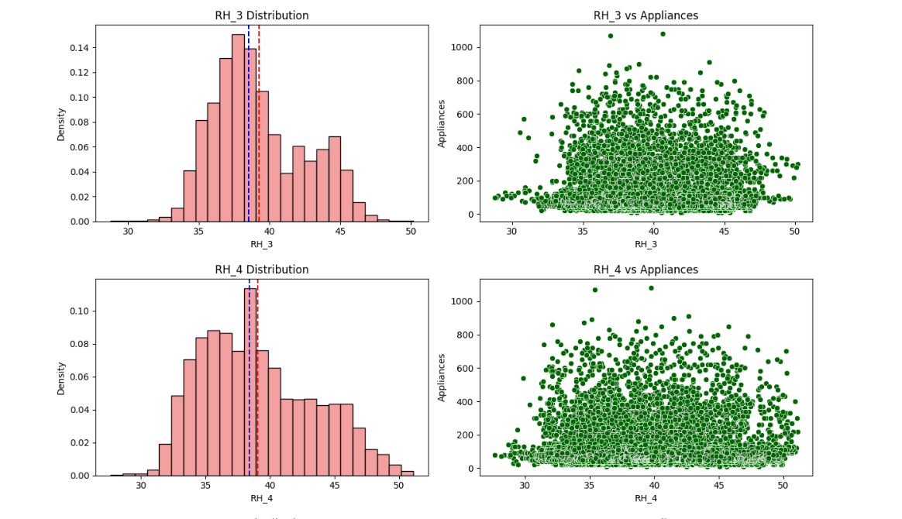
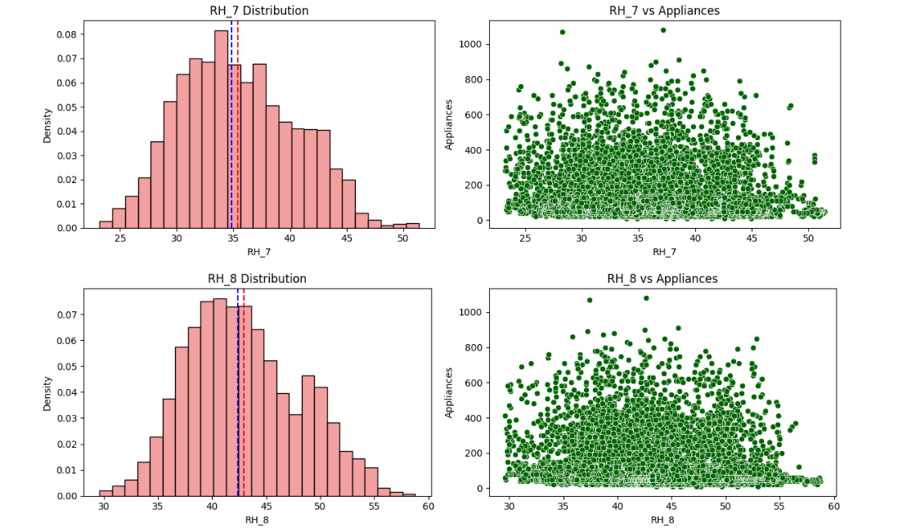
Humidity Distribution and Relationship with Appliance Energy Consumption

Slide 9
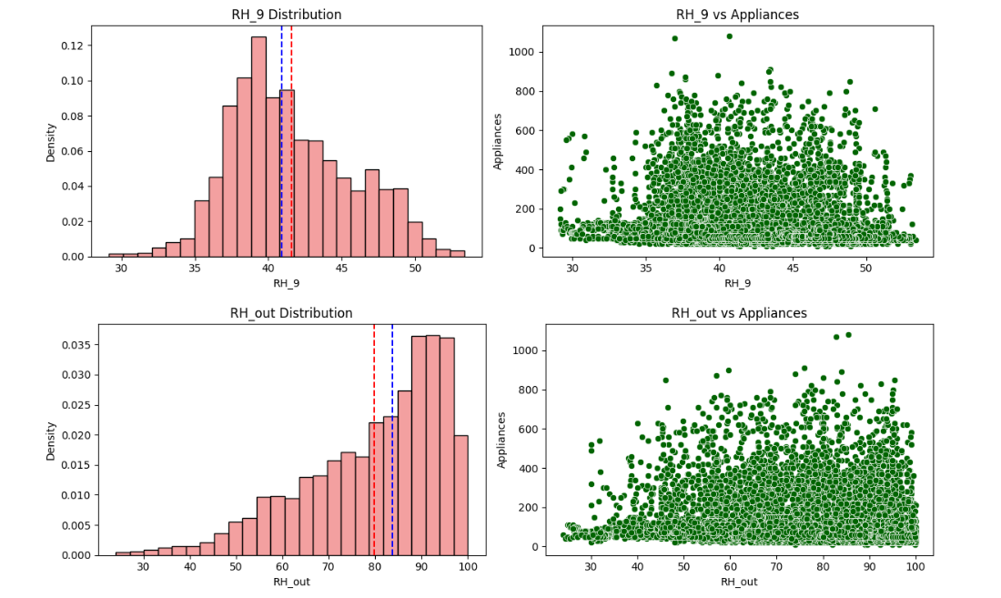
Most humidity features (RH_1–RH_9) show approximately normal or slightly skewed distributions, indicating stable indoor humidity conditions.
RH_5, RH_6, and RH_out exhibit higher variability compared to other humidity features.
The mean and median values for most humidity variables are relatively close, suggesting limited skewness.
Scatter plots show a weak relationship between humidity features and appliance energy consumption
Energy consumption varies significantly across all humidity levels, indicating that humidity alone is not a strong predictor.
Some humidity features display a wider spread and may capture environmental variations useful for prediction.
Humidity features can provide additional predictive power when combined with temperature and weather-related variables.

Slide 10
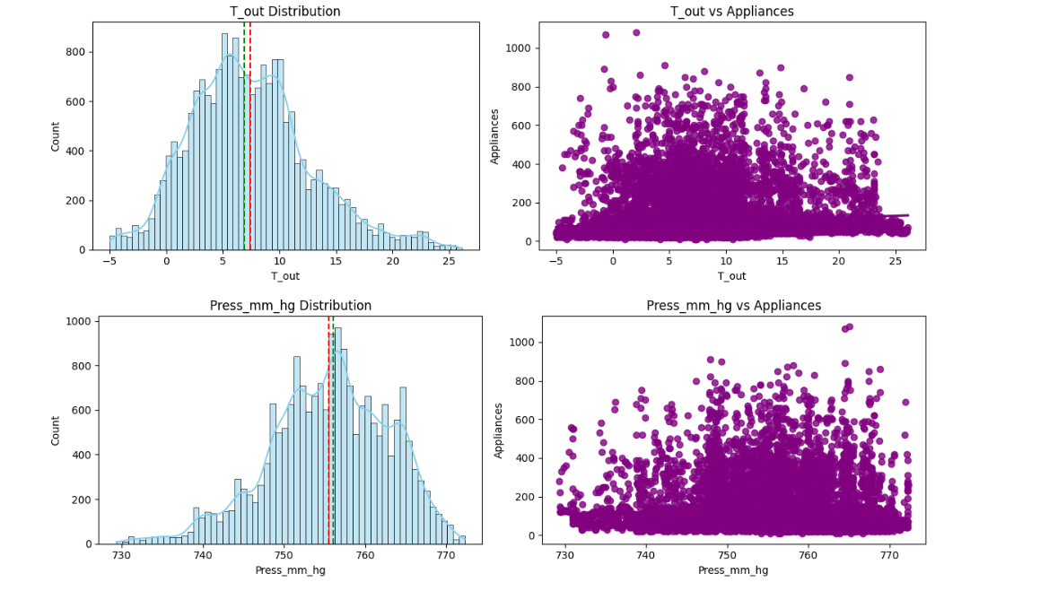
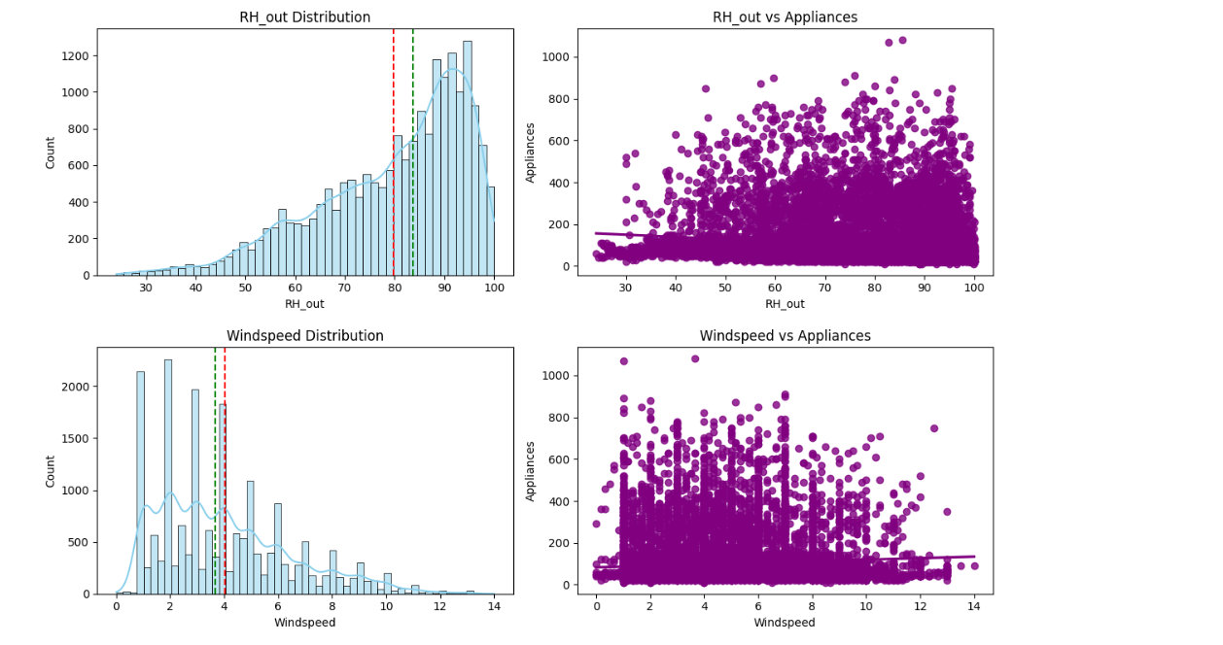
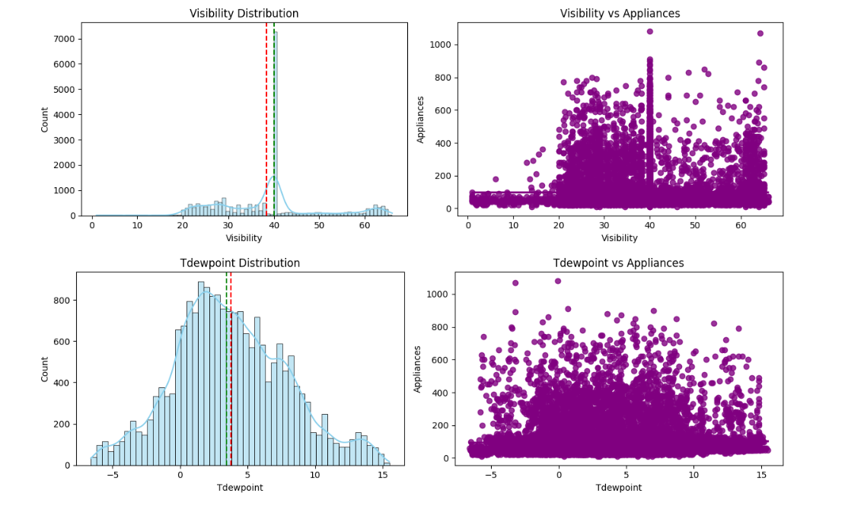
Weather Features Distribution and Their Impact on Appliance Energy Consumption
Weather features such as outdoor temperature, humidity, wind speed, visibility, and dew point exhibit varying distributions, with some features showing slight skewness. The scatter plots indicate a weak relationship between individual weather variables and appliance energy consumption, as energy usage varies across all weather conditions. Although no single weather feature strongly influences appliance consumption, these variables provide valuable environmental information and can improve prediction performance when combined with other features.

Slide 11
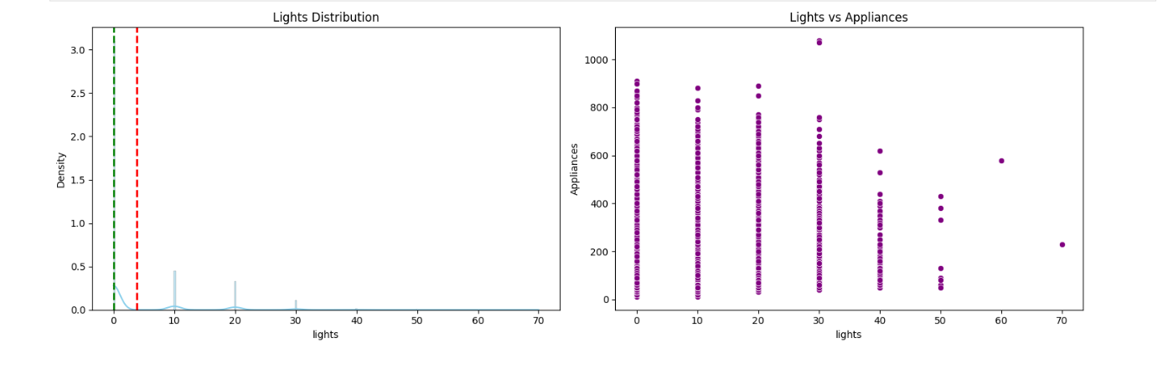
Analysis of Lighting Energy Consumption
The lights feature is highly right-skewed, with most observations concentrated at lower lighting energy consumption values and only a few records showing higher usage. The scatter plot indicates a weak relationship between lighting consumption and appliance energy consumption, as appliance usage varies across all lighting levels. This suggests that lighting energy consumption alone is not a strong predictor of appliance energy usage, but it may still provide useful information when combined with other features.

Slide 12
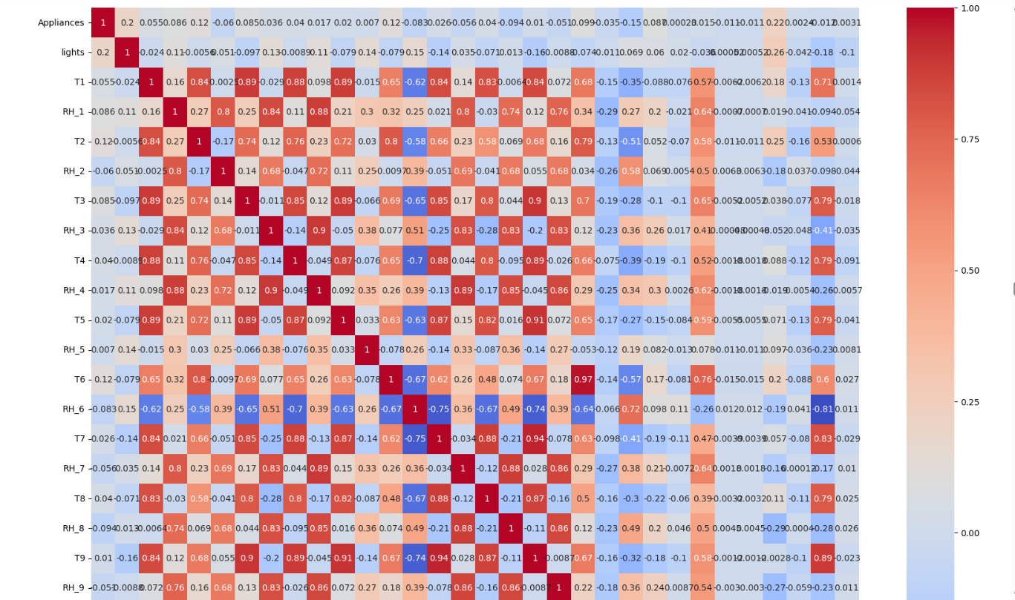
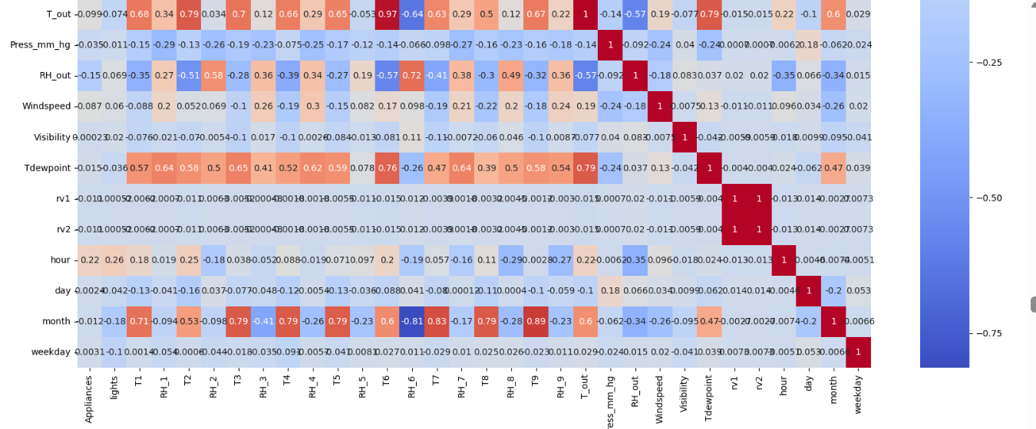
CORRELATION HEATMAP
Most features have a weak correlation with appliance energy consumption.
T2, T6, and T_out show the highest positive correlation among temperature features.
RH_out has the strongest negative correlation with appliance energy consumption.
Visibility, Tdewpoint, rv1, and rv2 show almost no correlation with the target variable.
Several temperature and humidity features are highly correlated with each other, indicating multicollinearity.
Appliance energy consumption is influenced by a combination of multiple features rather than any single variable.

Slide 13
Feature Engineering & Data Pipeline
1
O
Outlier Treatment→ Applied IQR method and capped extreme values to reduce the impact of outliers.
2
Feature Engineering → Created Average Temperature, Average Humidity, Temperature Difference, and Humidity Difference features.
3
Multicollinearity Check→ Calculated VIF scores and removed highly correlated features to reduce multicollinearity.
4
Feature Selection→ Retained the most relevant features and removed low-impact variables to improve model performance.
5
Data Transformation→ Applied Log Transformation on Appliances and Windspeed to reduce skewness and normalize distributions.
6
Train-Test Split→ Split the dataset into 80% training and 20% testing sets for model evaluation.
7
Feature Scaling→ Applied MinMaxScaler to normalize feature values before model training.

Slide 14
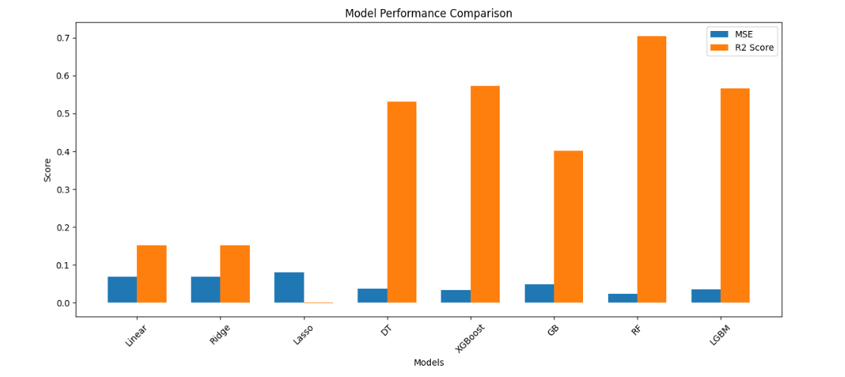
MODEL COMPARISON
8 Models Evaluated — Random Forest Wins
Model | MAE | R²
LinearRegresseion | 0.06882 | 0.152333
ridge | 0.06885 | 0.15190369
Lasso | 0.081211 | -0.0002329
DecisionTree | 0.0380289 | 0.53162
🏆Random Forest | 0.02391 | 0.705438
XGBOOST | 0.03465 | 0.57317
Gradient bossting | 0.40121 | 0.0486169
LGBM | 0.0351424 | 0.56717

Slide 15
Cross Validation & Hyperparameter Tuning
Objective
Optimize the Random Forest model by selecting the best combination of hyperparameters using GridSearchCV and Cross Validation.
Parameters Tuned
Number of Trees (n_estimators) : 100, 150, 200
Maximum Tree Depth (max_depth) : 10, 20, 30, None
Minimum Samples per Leaf (min_samples_leaf) : 1, 2, 5
Maximum Features (max_features) : sqrt, log2
Bootstrap Sampling : True, False
Methodology
Applied 3-Fold Cross Validation
Evaluated multiple parameter combinations using GridSearchCV
Selected the model with the highest validation performance
Best Parameters
Bootstrap = False
Max Depth = 30
Max Features = sqrt
Min Samples Leaf = 1
Number of Estimators = 200
Final Performance
R² Score = 0.736
MSE = 0.0214
Conclusion
Hyperparameter tuning improved the Random Forest model performance.
The tuned model achieved the highest predictive accuracy and was selected as the final model.

Slide 16
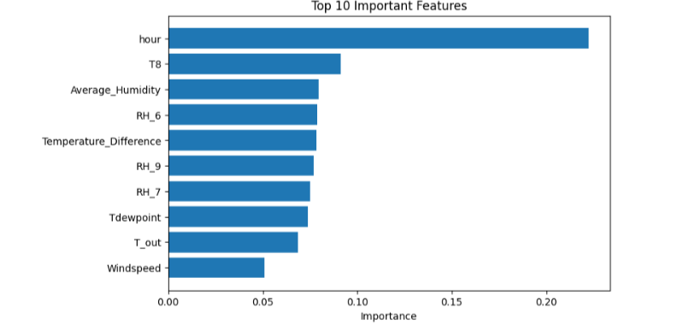
Feature Importance

Slide 17
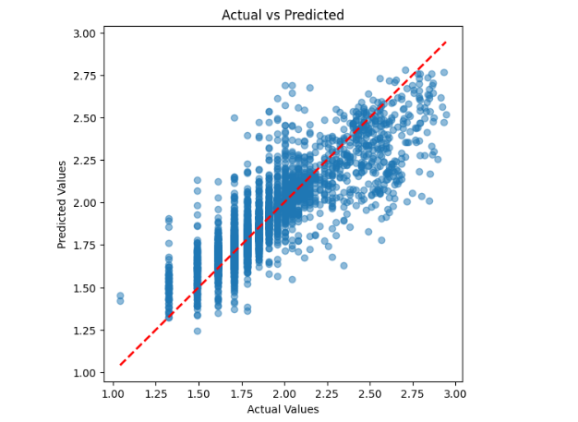
ACTUAL VS PREDICTED
The Random Forest model demonstrates good predictive performance.
The close alignment of points with the diagonal line confirms that the model can effectively estimate appliance energy consumption.
The obtained R² score of 0.736 indicates a strong fit between actual and predicted values.

Slide 18
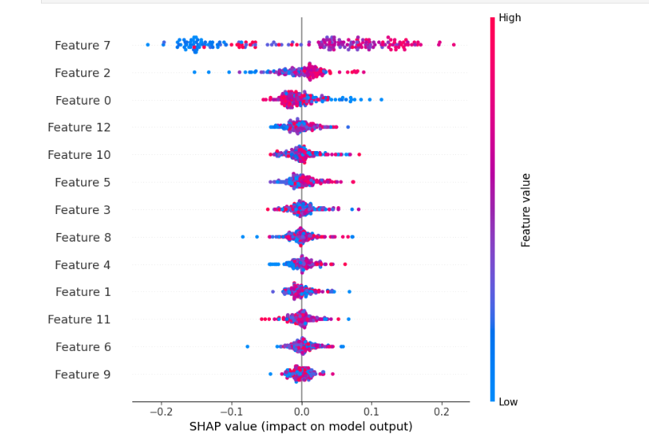
SHAP ANALYSIS
SHAP analysis identifies the features that have the greatest impact on appliance energy consumption predictions.
Feature 7 has the highest influence on the model output, followed by Feature 2 and Feature 0.
Features at the top of the plot contribute more significantly to predictions than those at the bottom.
Positive SHAP values increase the predicted energy consumption, while negative SHAP values decrease it.
The color gradient indicates feature values, where red represents higher values and blue represents lower values.
The model relies on a combination of multiple features rather than a single dominant variable.

Slide 19
LIMITATIONS
The dataset covers only 4.5 months of observations, limiting the capture of long-term seasonal trends.
Appliance energy consumption is influenced by occupant behavior, which is not directly included in the dataset.
Several temperature and humidity features exhibit multicollinearity, affecting feature interpretability.
The model was trained on data from a specific household environment, which may limit generalization to other homes.
External factors such as appliance type, occupancy patterns, and lifestyle habits are not fully represented.
Prediction accuracy may decrease when applied to environments significantly different from the training data.
The model explains approximately 73.6% of the variance, indicating that some factors influencing energy consumption remain unaccounted for.
Future Enhancements
Incorporate additional features such as occupancy patterns, appliance usage schedules, and smart meter data to improve prediction accuracy.
Explore advanced deep learning models such as LSTM and GRU for capturing temporal patterns in energy consumption.
Develop a real-time energy monitoring and prediction system for smart home applications.
Integrate renewable energy and weather forecasting data to support intelligent energy management and optimization.

Slide 20
CONCLUSION
Random Forest achieved the best performance with R² = 0.736 and MSE = 0.0214 among all evaluated models.
Feature engineering, log transformation, and hyperparameter tuning significantly improved prediction accuracy.
Temperature, humidity, weather, and time-related features collectively influenced appliance energy consumption.
The developed model can support smart energy management and efficient household energy planning.

Slide 21
THANK YOU

